Slide 1
Branch4
BART Analytics

Slide 2
To ride or not to ride Bart?
That is the question

Slide 3
Questions
What are the ridership yearly trends? What does the seasonality look like?
Hourly trends – when should I ride Bart if I don’t want a crowded train?
Was there an effect from a “Big Event” in 2016 to ridership?
Where people are exiting/boarding Bart the most?
Bart delays last ~2yrs
Weather affected?
Trends: When not to ride BART…

Slide 6
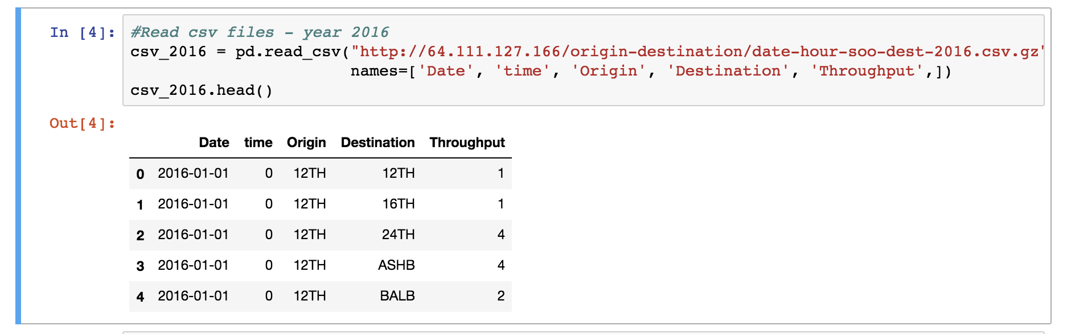
Code: Key Learnings
No need to download a large CSV file if a link to it is already available

Slide 7
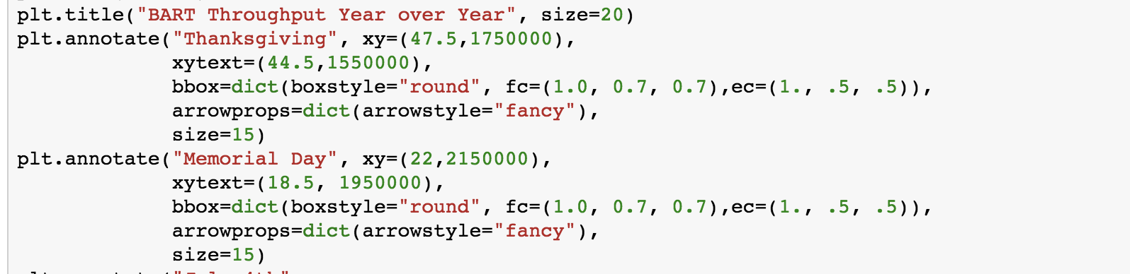
Code: Key Learnings
Annotate: Add notes directly to the chart

Slide 8
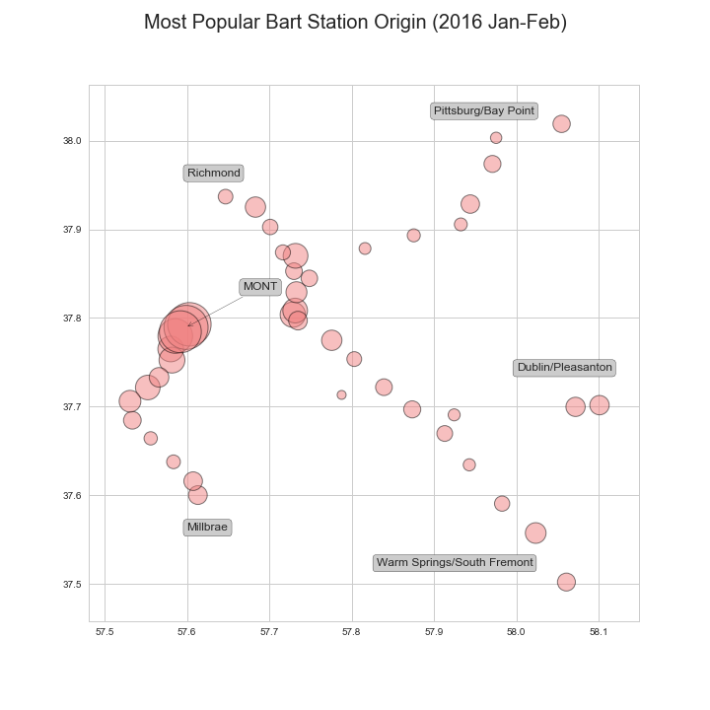
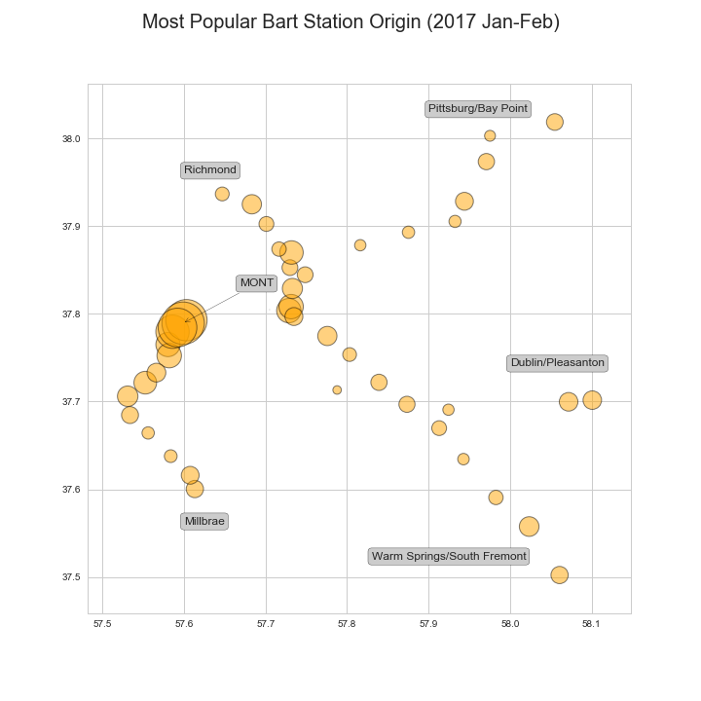
Super Bowl Impact– Origin station (Jan-Feb)

Slide 9
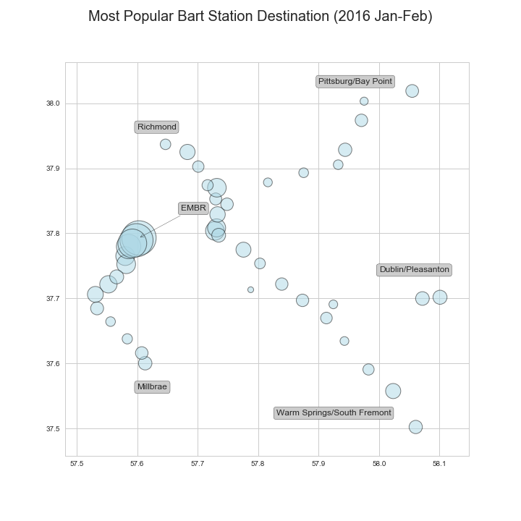
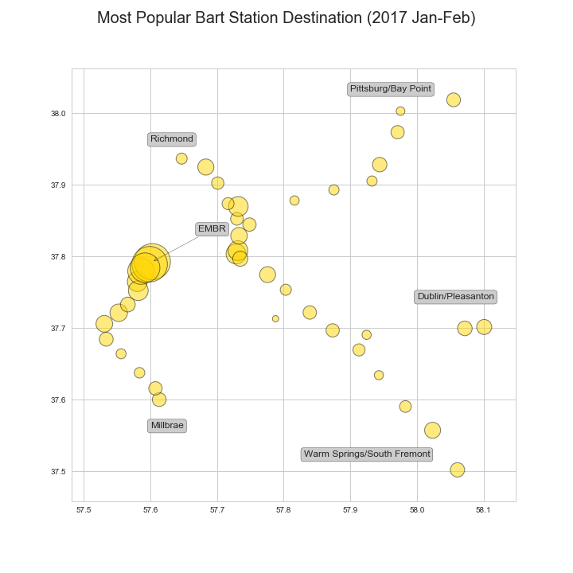
Super Bowl Impact– Destination (Jan-Feb)

Slide 10
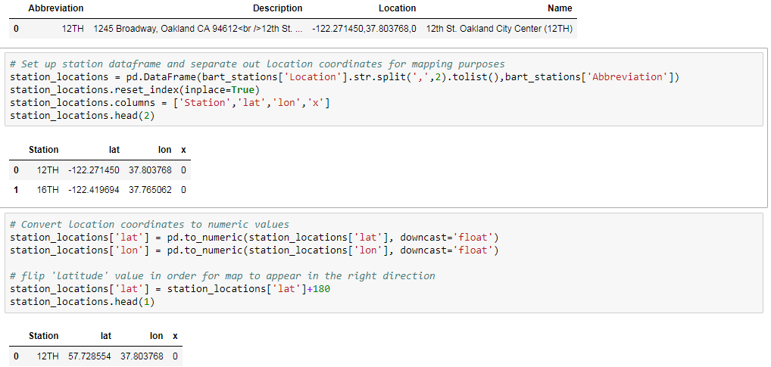
Key Learnings – Code
Station Location mapping required: Splitting out coordinates, converting to numeric and flipping direction:

Slide 11
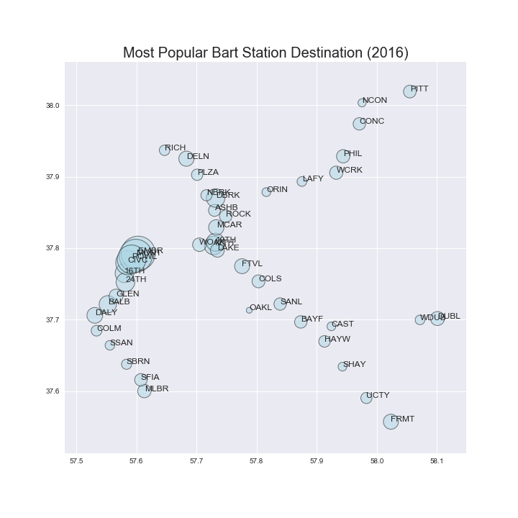
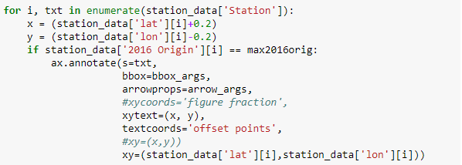
Key Learnings – Focus on Question
Original plan: add station names to all data points
Final result: add end point stations only and highlight most popular station

Slide 12
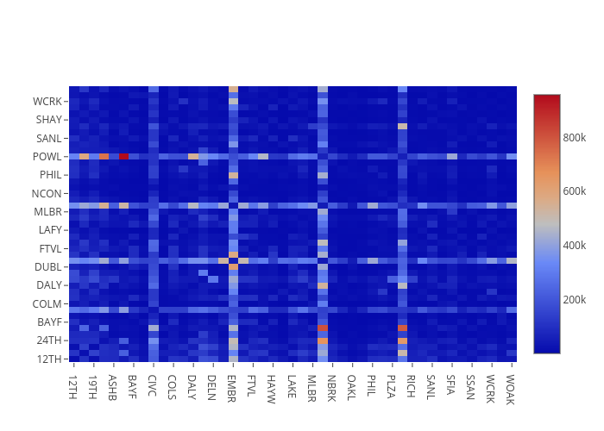
Throughput Between Stations (2015)
https://plot.ly/~tli2001/8/

Slide 13
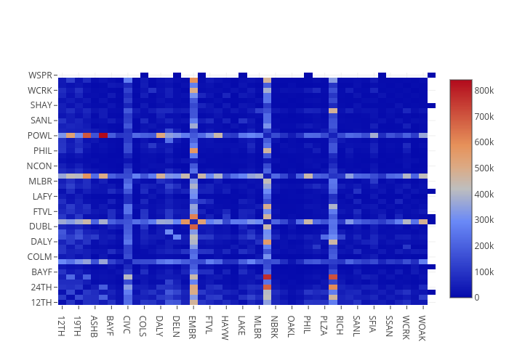
Throughput Between Stations (2016)
https://plot.ly/~tli2001/4/

Slide 14
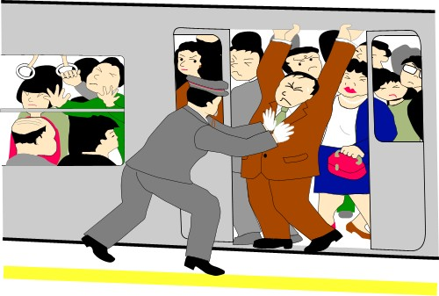

Popular Station Findings
Comparing the throughput of January-February of 2016 and 2017, there was an overall decrease in traffic in the year following the Super Bowl. We saw an average drop of 33,000 across all stations, including a drop of over 200,000 in the most popular destination station in both years – Embarcadero Station.
Looking at the full year throughput between 2015 and 2016 (2017 data was incomplete) we can see that the overall traffic pattern between stations looked largely similar, so the Super Bowl primarily added volume but did not alter the traffic pattern .
Verdict: If you need to travel to or through downtown San Francisco - specifically Embarcadero, Montgomery, Powell, or Civic Center, there’s a high possibility of the trains being packed due to the popularity of these stations.

Slide 15
Appendix

Slide 16
Resources used
Bart.gov ridership raw data: http://64.111.127.166/origin-destination/
Twitter API

Slide 17
Key terms
Throughput: Number of people that click in/out of a station

Slide 18
Split
Melody
Seasonality
Hourly trends – when should I ride Bart if I don’t want a crowded train
Mayur/Tony
What is the increase in ridership during the Superbowl 2016?
Heatmap by day
Where people are boarding the Bart the most?
Bubble plot by station/map
Where people are exiting the Bart the most?
Lena
Bart delays last ~2yrs
Weather affected?
Trends: When not to ride BART

